Slide 1

The Fighting Mongooses
Nick Sigurdson, Steven Schlenker, Keith Schoen, Rebeca Soto, Erik Porter, Jabril Smith

Slide 2
What went well...
Deployment: We were able to deliver two deployment methods to cover all use cases
Troubleshooting: We had several issues with the API calls and were able to get them all resolved

Slide 3
What went poorly...
Communication stalled for a small duration of the project but did improve.
Merge Conflicts: We had few merge conflicts

Slide 4
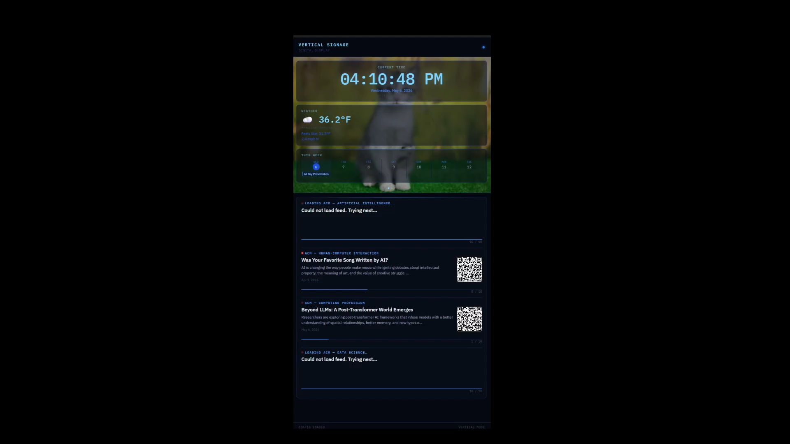

Slide 5
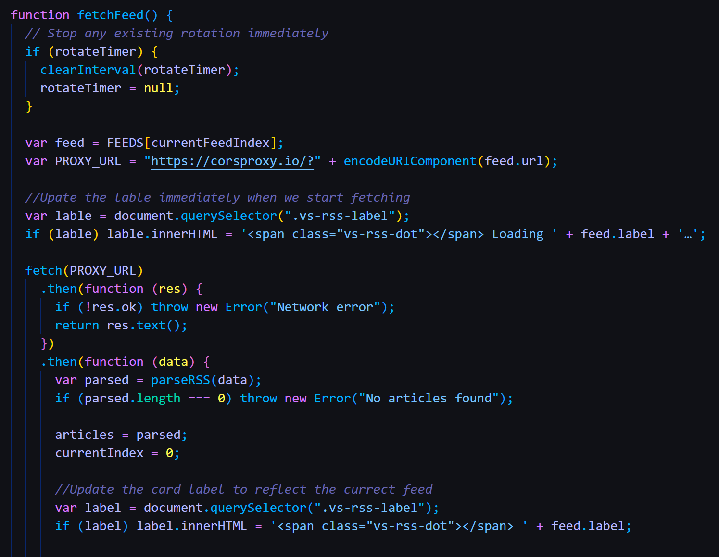
Fixing the feed
This sprint was a simple-ish bug-hunt within the rss.js file.
  Goals were to fix a logic issue with repeating feeds and a few formatting glitches that occurred with the updated visuals.
All bugs were successfully squashed, and the RSS feed runs as expected.

Slide 6
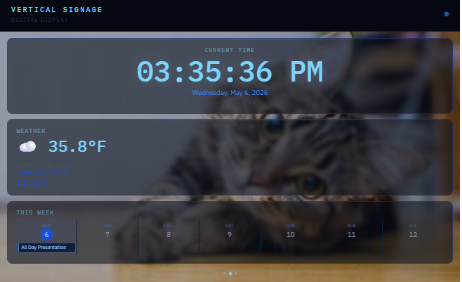
Calendar Implementation
Further work on calendar implementation as well as stylization. Correct orientation as well as showing times vs all day events
Notes:
Going the API route for the calendar offers far more options in terms of customizability and stylization. Very few limitations that I could find when using the API

Slide 7
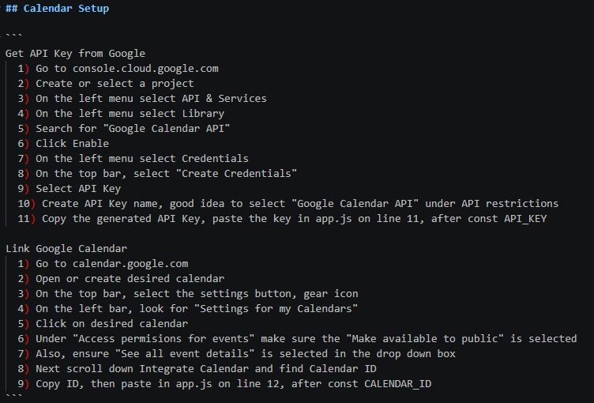
Calendar Setup
Added instructions to README on how to add personal calendar to the app
Notes:
Adding API Key isn't necessarily difficult, but tedious. Can be tricky to navigate the pages, as Google projects looks pretty terrible and confusing to get around
Linking a Google Calendar is much easier and straight forward though

Slide 8
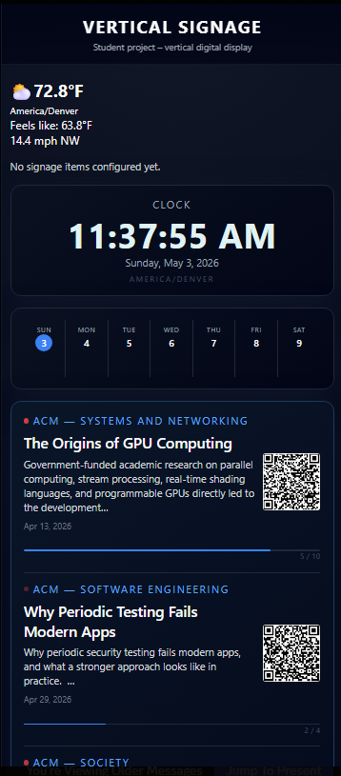
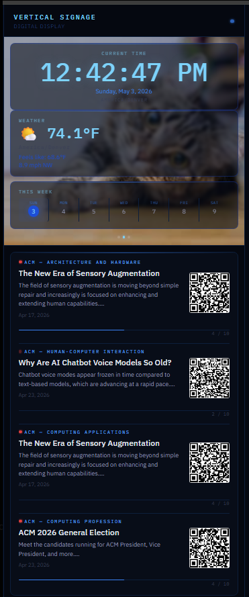
Final Look of Program
We decided to go for a more professional look to the program. We were also able to add a customizable slideshow of images since the teacher asked for it. The newer version came out to be a quite simple and clean way to see a live clock, weather, calendar, and certain news sources.
Before
After

Slide 9
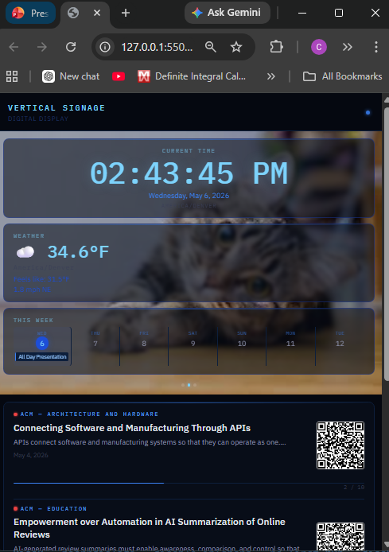
Deployment
While using the VS Code live server addon to test our program it was not a great way to run the final product. After doing tons of research on what would work best to run our program, we saw things such as electron and NPX through node.js. Live server for example would just bring up a google tab that wouldn’t update constantly and have google URL, bookmarks, etc.

Slide 10
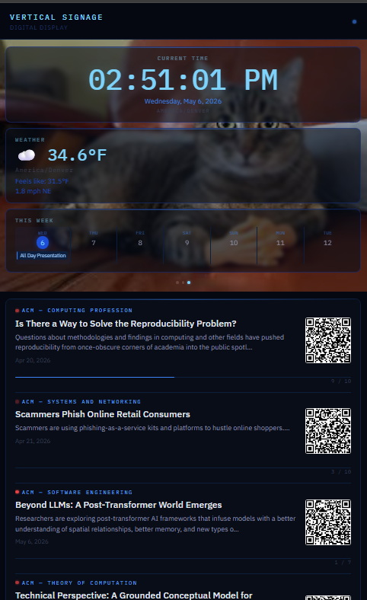
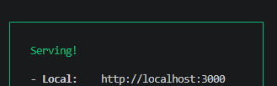
Deployment Cont.
We decided to go with Node.js NPX system.
It runs completely through either vs codes terminal or your pc command.
You start the server with NPX serve till you see the server started
In a new terminal you go to that newly started server with another command.
For more details, there is a document for deployment in github repo.
This way a live server will be running and can be told to start when the machine is started so it is always active and online.
This will also get rid of any browser information such as the URL bar or bookmarks.

Slide 11
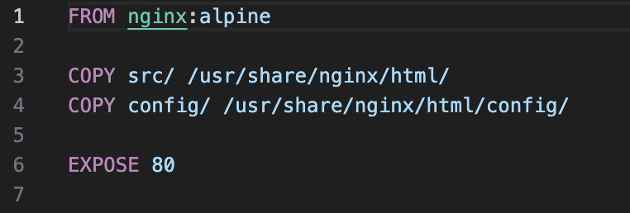
Container Deployment
Uses nginx on alpine OS
Copies in files from our src directory
Copies in our config
And exposes on port 80
Notes:
Base image is nginx:alpine — minimal Linux with nginx pre-configured
Dockerfile copies src/ and config/ into the nginx web root
No build step needed — plain HTML, CSS, and JS served directly
Build with: docker build -t vertical-signage-test .
Run with: docker run -d -p 8080:80 --name vertical-signage-test vertical-signage-test
View at http://localhost:8080
Stop and rebuild after changes: stop → rm → build → run

Slide 12
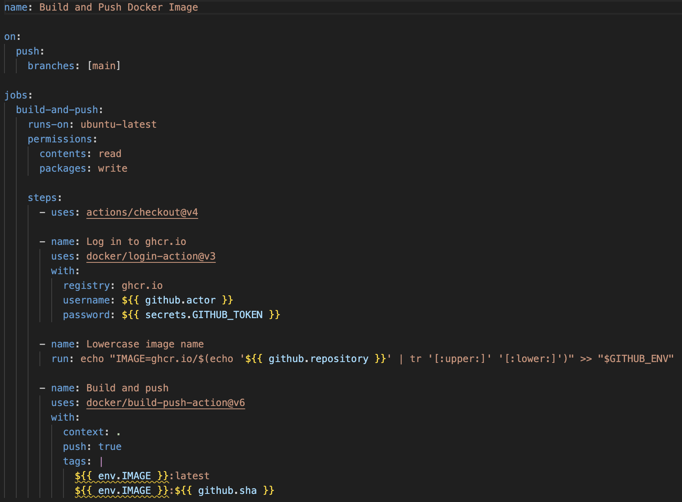
Container Deployment
Serves all users and hardware
Portable
Notes:
Workflow lives at .github/workflows/docker.yml
Triggers on any push or merged PR to the main branch
Authenticates to ghcr.io automatically via GITHUB_TOKEN — no manual secrets needed
Builds the image from the Dockerfile and pushes two tags: :latest and :<git-sha> for rollbacks
Published at ghcr.io/thefightingmong00ses/vertical-signage
Pull and run on any machine: docker pull ghcr.io/thefightingmong00ses/vertical-signage:latest
Monitor builds in the Actions tab on GitHub

Slide 13
Code Statistics
SLoC:1481
  1643 insertions(+), 1006 deletions(-)
Static Code Analysis
  Cyclomatic Complexity: Static analysis identified 6 warnings, primarily due to large function sizes and moderate cyclomatic complexity. The most complex function had a complexity of 13, slightly above the recommended threshold of 10.
  Average method length is approximately 60–70 lines per function.

Slide 14

SDLC statistics
Sprint Backlog: 8 completed stories
Velocity: 18 tasks this sprint

Slide 15
Team Name | Hours Worked | Activity
Rebeca Soto | 26 | Added caching and error recovery, debugged CORS, ports, and fetch issues and Managed Git branches, merges, and rebases
Jabril Smith | 14 | Research, Test clock and API call. Docker deployment, CI/CD to build container
Erik Porter | 12 | Research, documentation and presentation, deployment, and html/CSS customization.
Steven Schlenker | 7 | De-bugging, investigating corsproxy.io vs AurariaNet, screen capture of working product
Keith Schoen | 6 | Fixed logic issue causing duplicate feeds to generate. Fixed minor errors in card formatting brough on by visual update.
Nick Sigurdson | 1 | Further implementation of the calendar API. Created README instructions for setting up calendar

